Slide 1

THE INFORCERS
Team meeting
Friday 06/08/2018

Slide 2

#10 in the country with
$161,390 submitted!
The Inforcers are….
Last week Rank #20 with $97,452 submitted

Slide 3
The Inforcers Numbers
 | THIS WEEK
 | DAVID REED |  | $58,294
 | IVELINA DIMITRVA |  | $16,779
 | JEFF PETTAY |  | $7,159
 | CORY MOORE |  | $5,570
 | BRYAN DASKAM |  | $4,668
 | RICK ATTANASIO |  | $4,636
 | ASHLEIGH BRAGA |  | $346
 | TEAM TOTAL: |  | $97,452
 | TEAM AVERAGE: |  | $13,922
LAST WEEK
This WEEK
Rank Name Total AV
1 DAVID REED $74,563
2 ASHLEIGH BRAGA $48,396
3 IVELINA DIMITROVA $19,607
4 DELENE DARCEL $9,438
5 RICK ATTANASIO $9,387
Team Total: $161,391
Team Average: $32,278

Slide 4
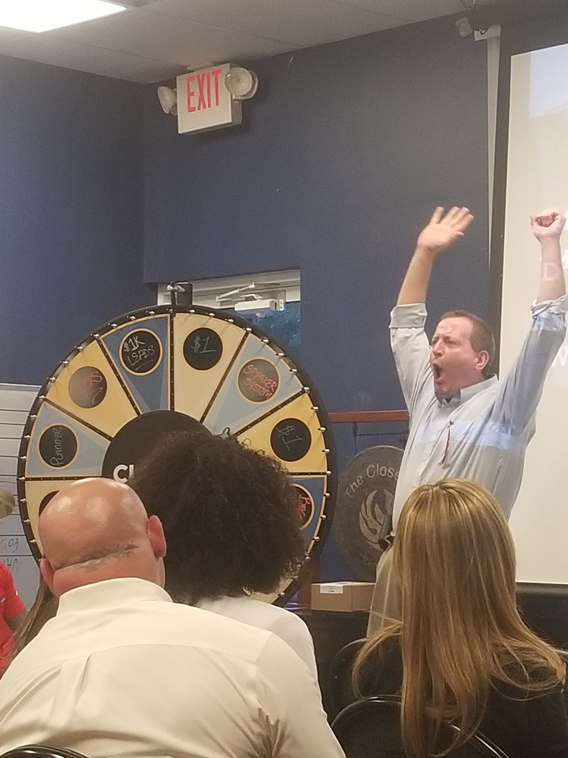
TOP PRODUCER!!
David Reed
(AGAIN AND AGAIN)

Slide 5
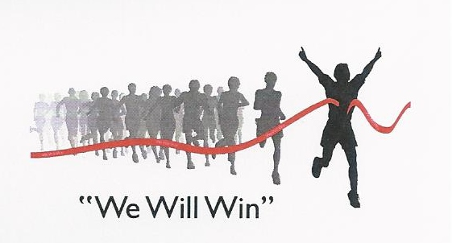
OUR GOALS!
TOTAL SUBMITTED AV
TOTAL APPS SUBMITTED
WE WILL SUBMIT $100,000 !!
WE WILL SUBMIT 30 APPS- AND MOST IMPORTANTLY HELP 30 FAMILIES AND INDIVIDUALS SECURE THEIR ASSETS AND PROTECT THEIR WELL-BEINGS!
TOTAL ISSUED AV
WE WILL ISSUE AND GET PAID ON $100,000!!
$$$$$$$$$$$$$$$

Slide 6
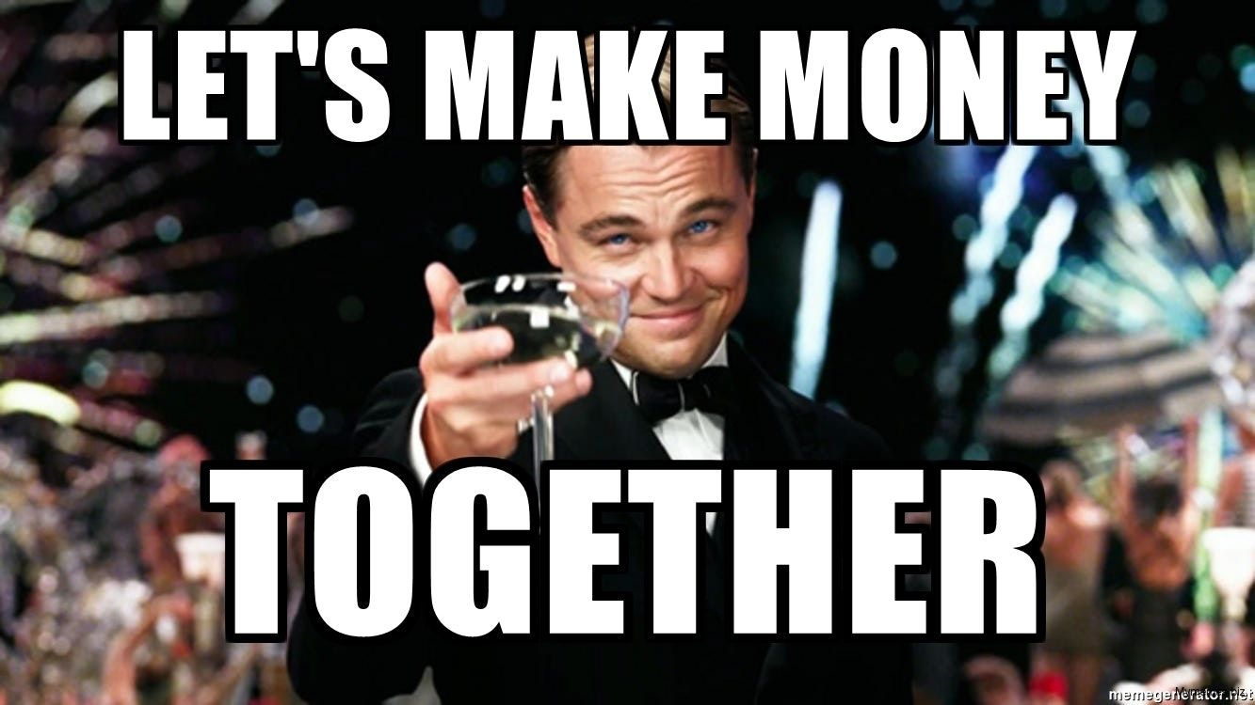


HIT IT---100K!!
IVELINA

Slide 7

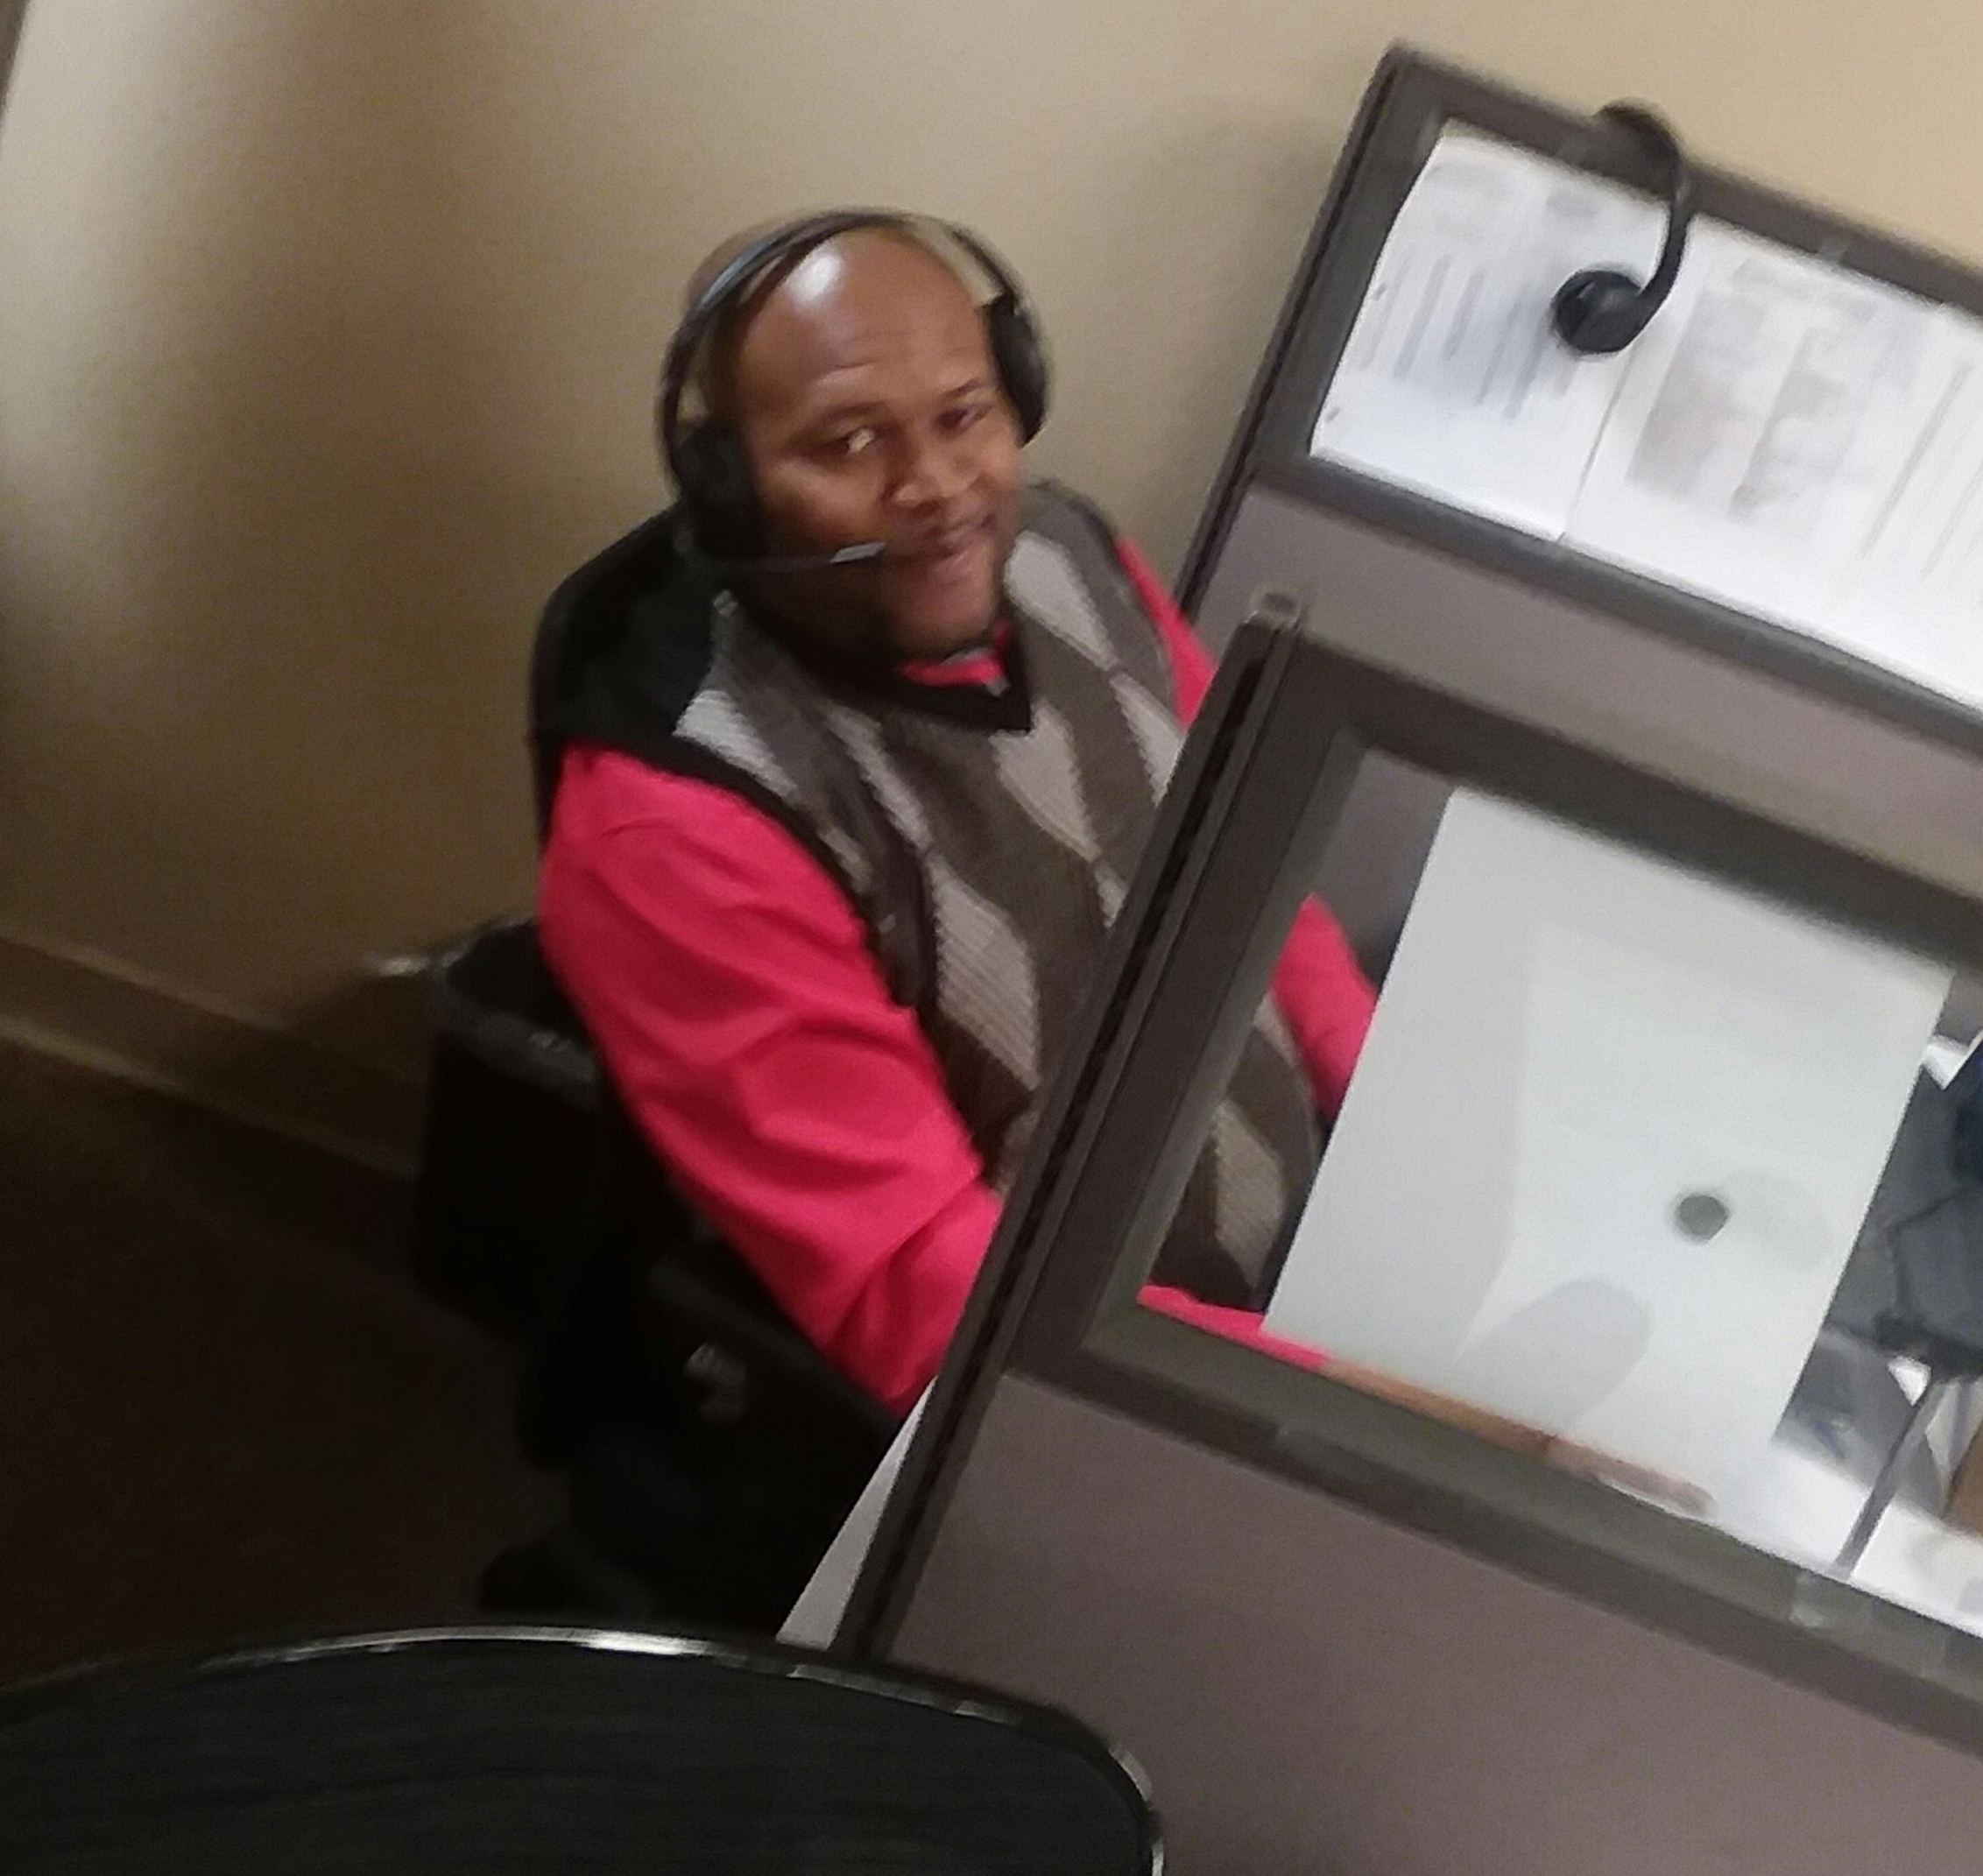

FIRST NEW BUSINESS
COREY!!!

Slide 8

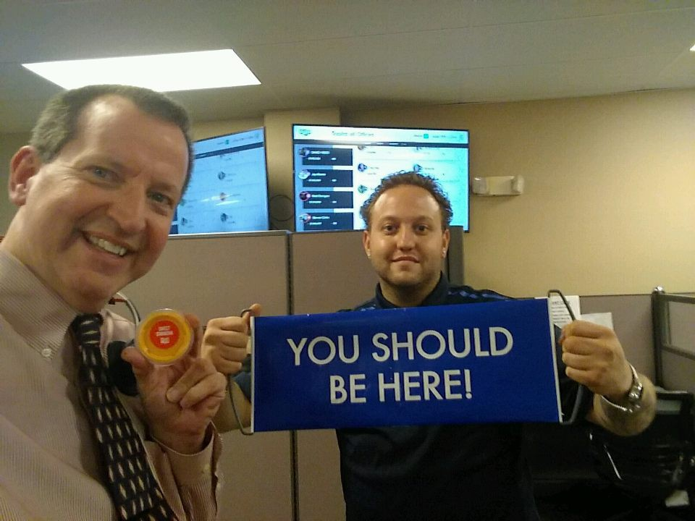
BOOTCAMP
NOW EVERY SATURDAY
EVERY OTHER SAT –BEGINNERS EVERY OTHER SAT - ADVANCED
TOMORROW 06/09/2018 - ADVANCED

Slide 9

Leaders in Cabo Week---Shine and Improve
Dial + Dial + Dial
2pm Training Every Day – but Wednesday
Friday 8am is HOT SEAT All agent

Slide 10
Have Fun Ash and Joe !
WE will be a better Team when you get back
and Ready to Level-Up!!!
ONE TEAM-ONE FIGHT!!

